Slide 1
Abundance
Relative Abundance
Ecosystem A
Ecosystem B

Slide 2
Legend
Fig. 1 It is important to draw distinctions between abundances and relative abundances in a unit volume of an ecosystem. As shown in this figure, all taxa may be identically abundant in a unit volume of two ecosystems, except for one differentially abundant taxon (the green variety). Due to this one differentially abundant taxon, the two ecosystems may differ in the relative abundance of all taxa. Thus, a single pathogen may alter the relative abundances of all remaining taxa between two otherwise identical ecosystems. A researcher may not only be interested in knowing if the mean relative abundance of a taxon is different between two ecosystems but, may also want to know if the abundance of a taxon is different in a unit volume of two ecosystems.

Slide 3
Subject A
Subject B
Ecosystem A
Ecosystem B
Specimen A
Specimen B
 | Sample | True
 | 4 | 12
 | 2 | 6
 | Library size = 6 | Microbial load = 18
 | Sample | True
 | 4 | 18
 | 2 | 9
 | Library size = 6 | Microbial load = 27

Slide 4
Legend
Fig. 2 Differential abundance analysis should account for the bias introduced by different sampling fractions. Sampling fraction is defined as the ratio of library size to the total microbial load. As shown in this example, the microbial load for subject A is 18 (12 red + 6 green), for subject B is 27 (18 red + 9 green), while the library sizes are the same for specimen A and B, which is 6 (4 red + 2 green). That leads a sampling fraction of 6/18 for specimen A versus 6/27 for specimen B. One may mistakenly conclude that the red and green taxa are not differentially abundant between two ecosystems without a proper normalization method, which is simply because specimen A has a larger sampling fraction than specimen B.

Slide 5
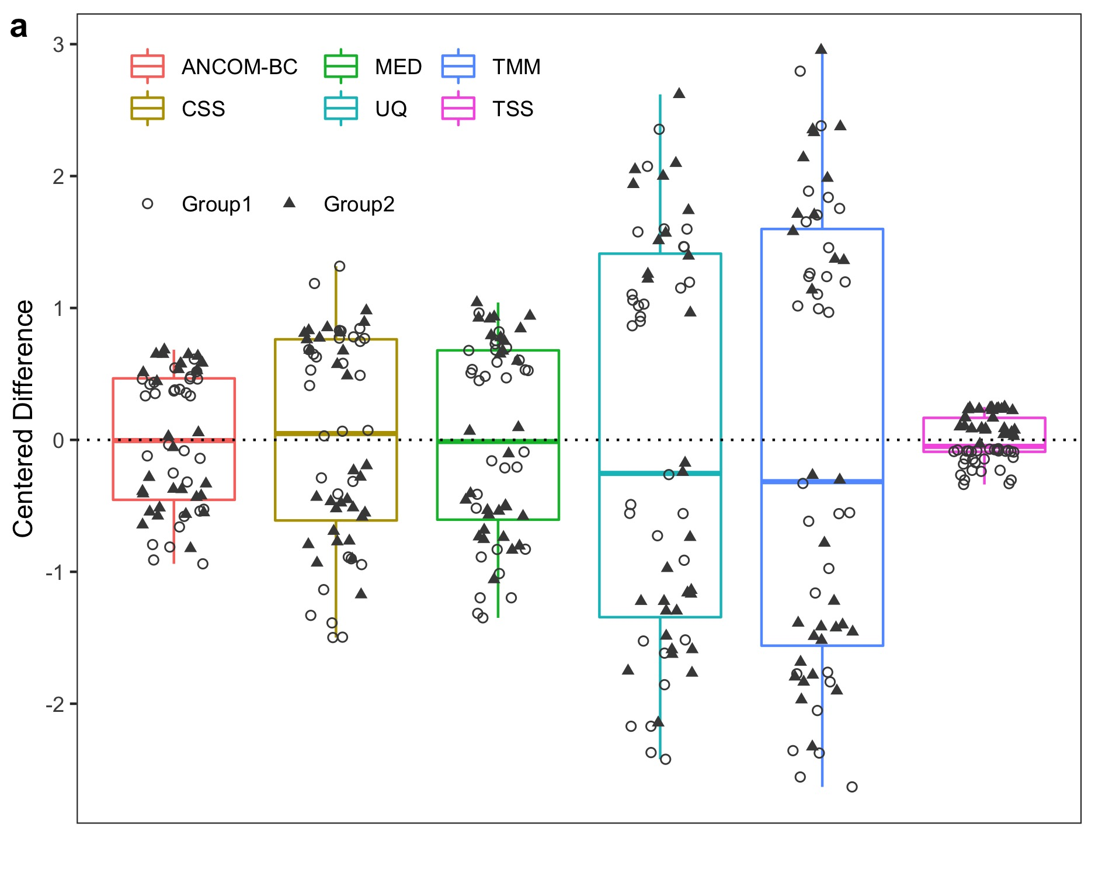

Slide 6
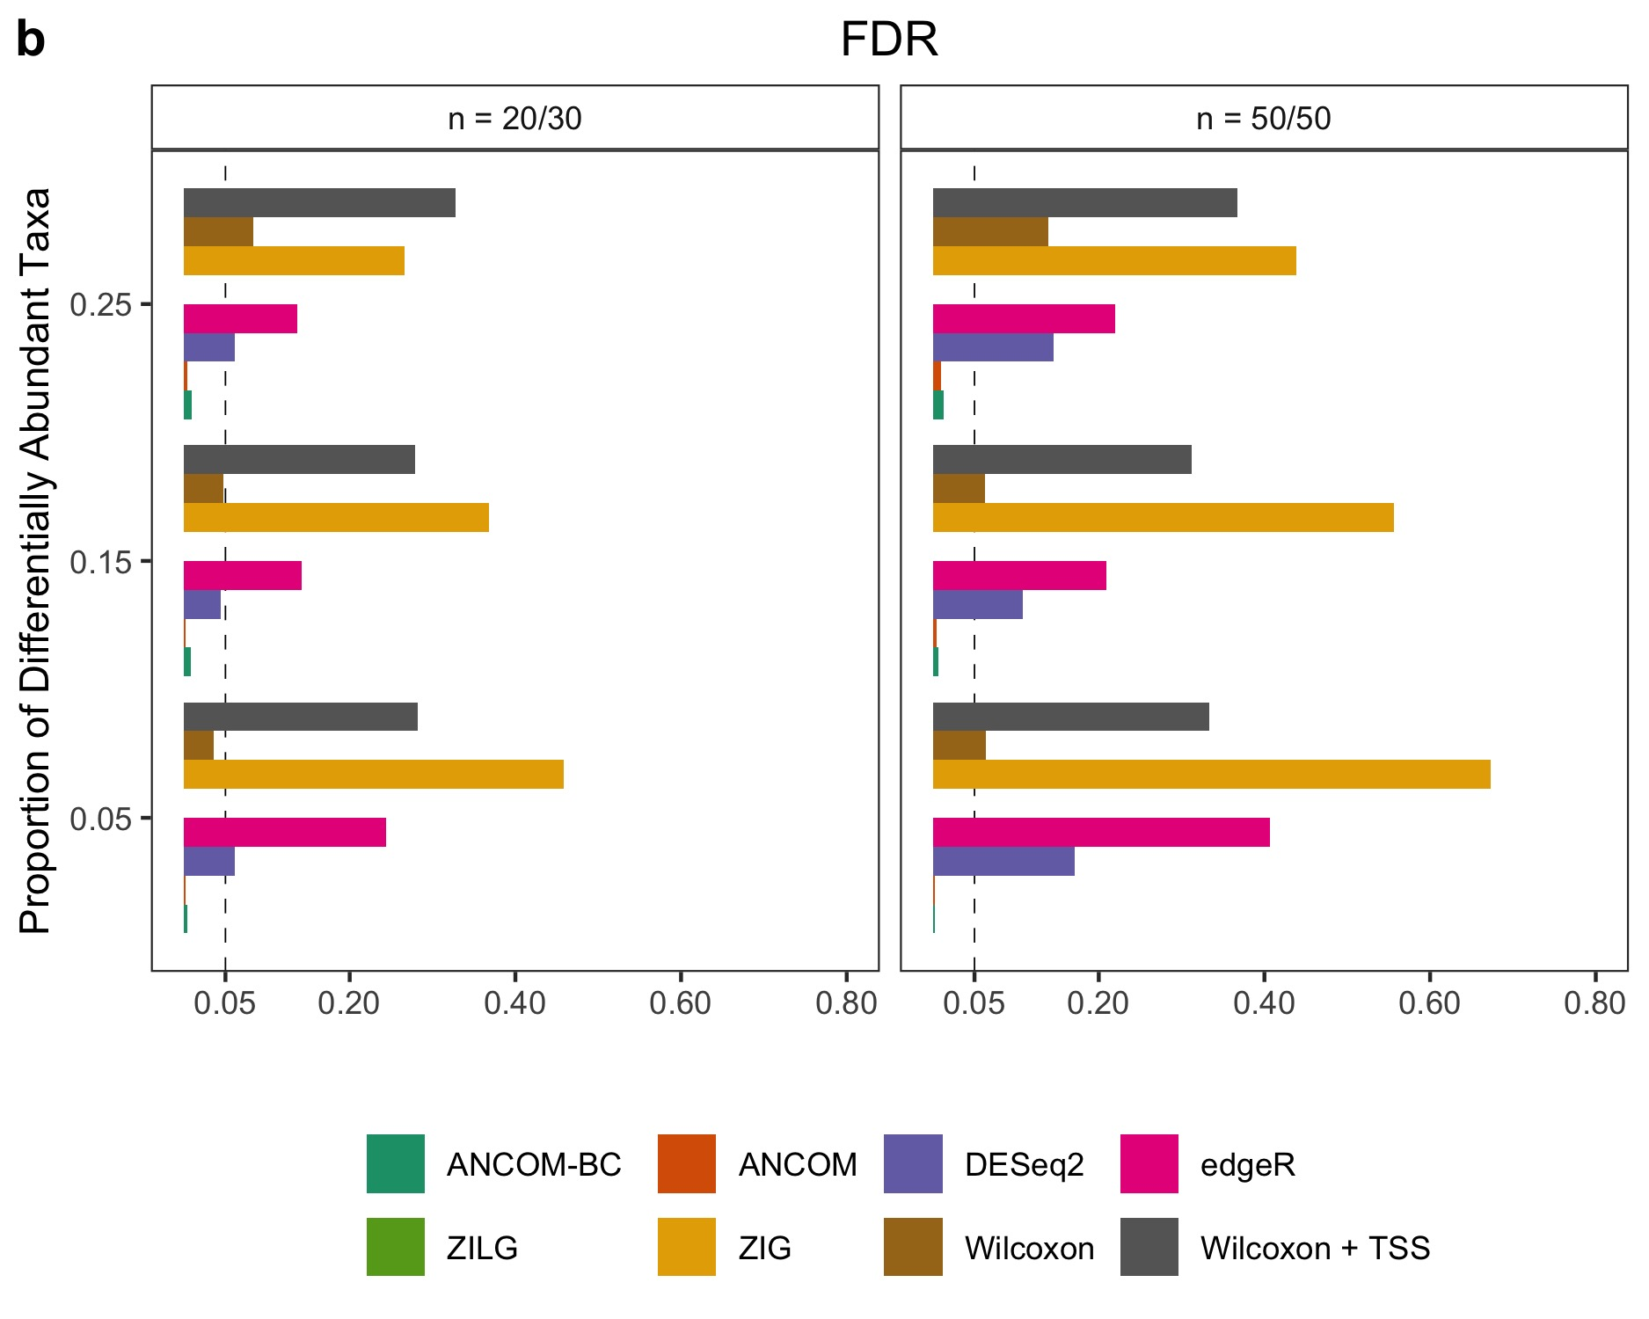

Slide 7
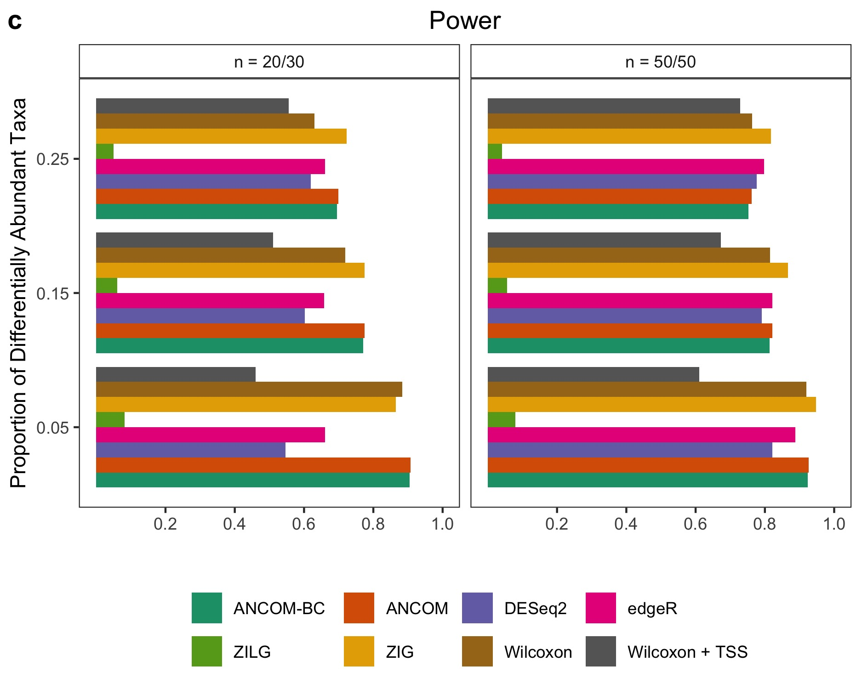

Slide 8
Legend
Fig. 3 Bias, FDR and power comparisons using synthetic data with the presence of large variable sampling fractions. a Box-plot of centered deviance (centered difference between true sampling fraction and its corresponding estimate) for each specimen. UQ and TMM have the largest variance, MED and CSS have larger variance compared to ANCOM-BC, TSS has the least. However, it shows that centered deviance are clearly separated by its group label using TSS, which indicates that TSS has a systematic bias of estimating sampling fractions since it totally neglect the total microbial load. b, c The False Discovery Rate (FDR) and power of various methods, respectively. The Y-axis denotes patterns of proportion of differential abundant taxa. Results show that only ANCOM and ANCOM-BC control the FDR under the nominal level (5%) while maintaining power comparable to other methods. Gaussian model version of metagenomeSeq has highly inflated FDR, while the log Gaussian version has substantial loss of power, sometimes well below 5%. Other than ANCOM-BC and ANCOM, as the sample size within each group increases, so does the FDR for all other existing methods. Simulation details could be found at Supplementary Text.

Slide 9
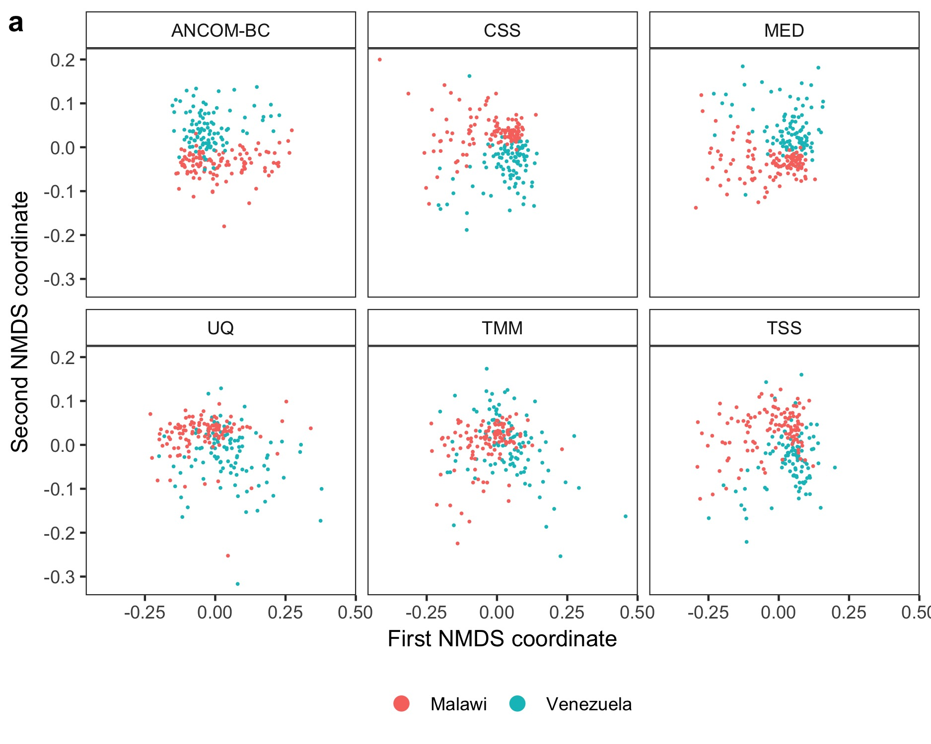

Slide 10
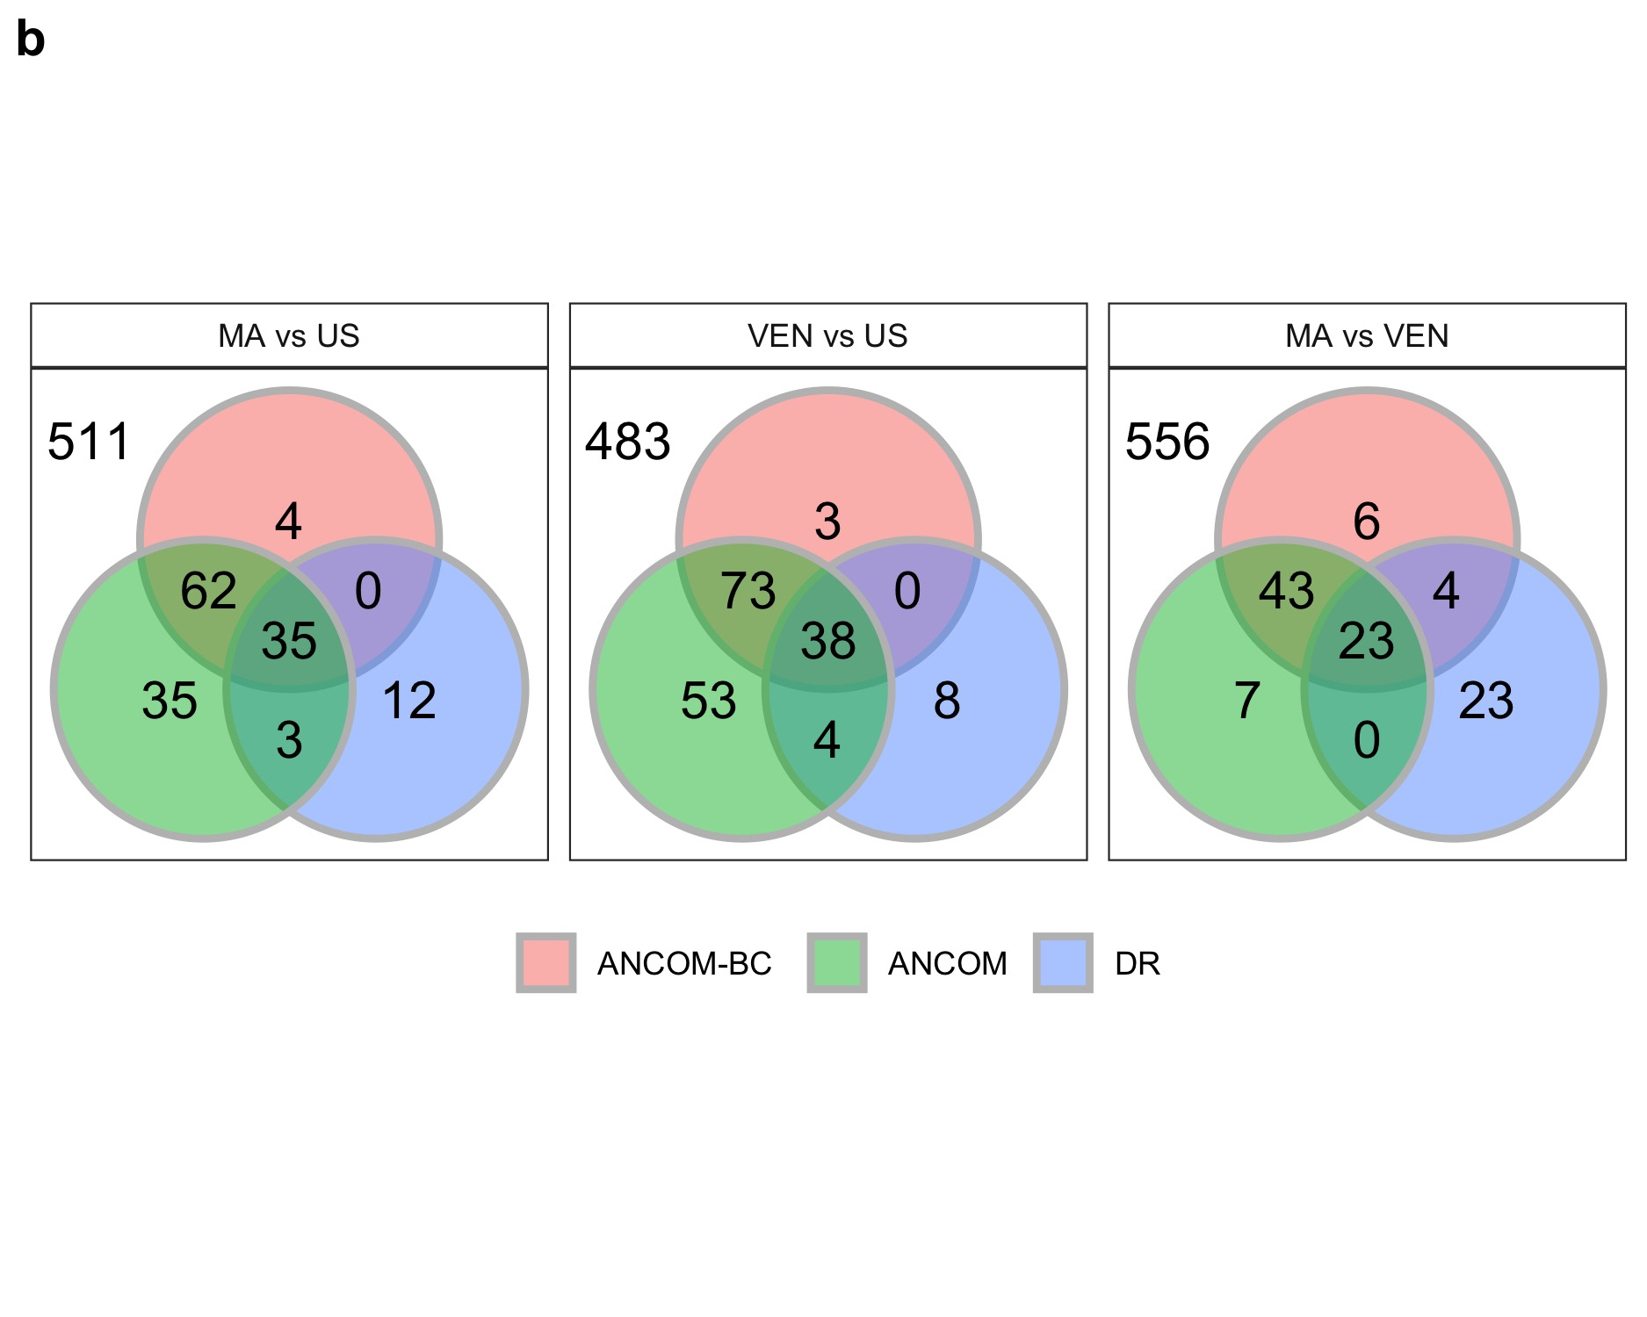

Slide 11
Legend
Fig. 4 Analysis of the global gut microbiota data in genus level. a First two non-metric multidimensional scaling (NMDS) coordinates to evaluate the performance of various normalization methods (ANCOM-BC, CSS, MED, UQ, TMM, and TSS) applied on Malawi and Venezuela samples. The normalization method used in ANCOM-BC appears to provide best separation between Malawi and Venezuela samples. CSS and MED also distinguish samples nicely which is in line with our findings using synthetic data shown in Fig. 3a, Supplementary Fig. S1a, S2a. b Venn Diagrams representing consistency of differentially abundant genera identified by ANCOM-BC, ANCOM and Differential Ranking (DR). We compare the abundance data of (1) Malawi vs US, (2) Venezuela vs US, and (3) Malawi vs Venezuela. ANCOM-BC and ANCOM generally have large overlap of significant genera, while in the case of Malawi vs Venezuela comparison, there were more taxa uniquely identified by DR.

Slide 12
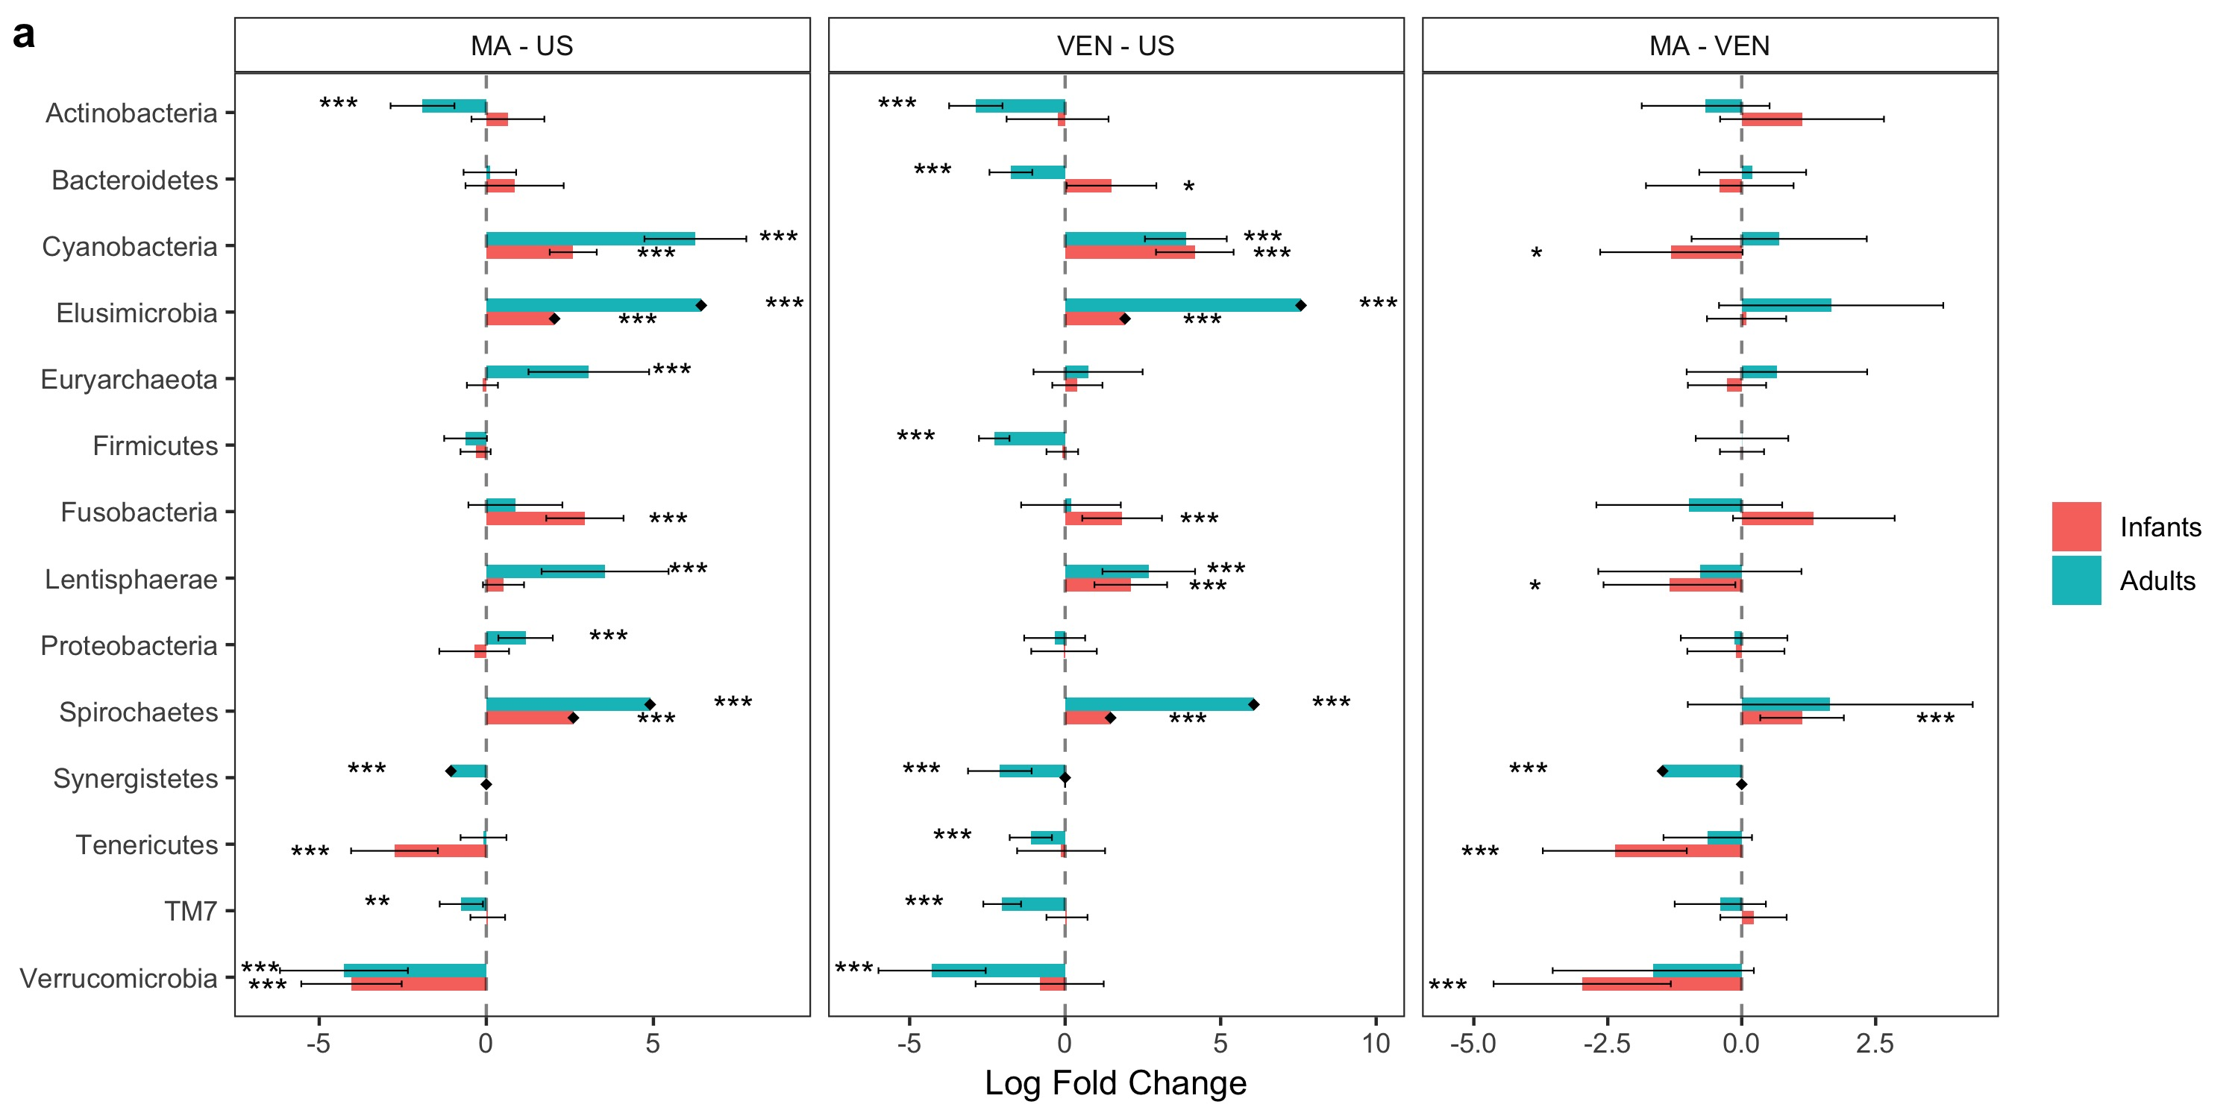

Slide 13
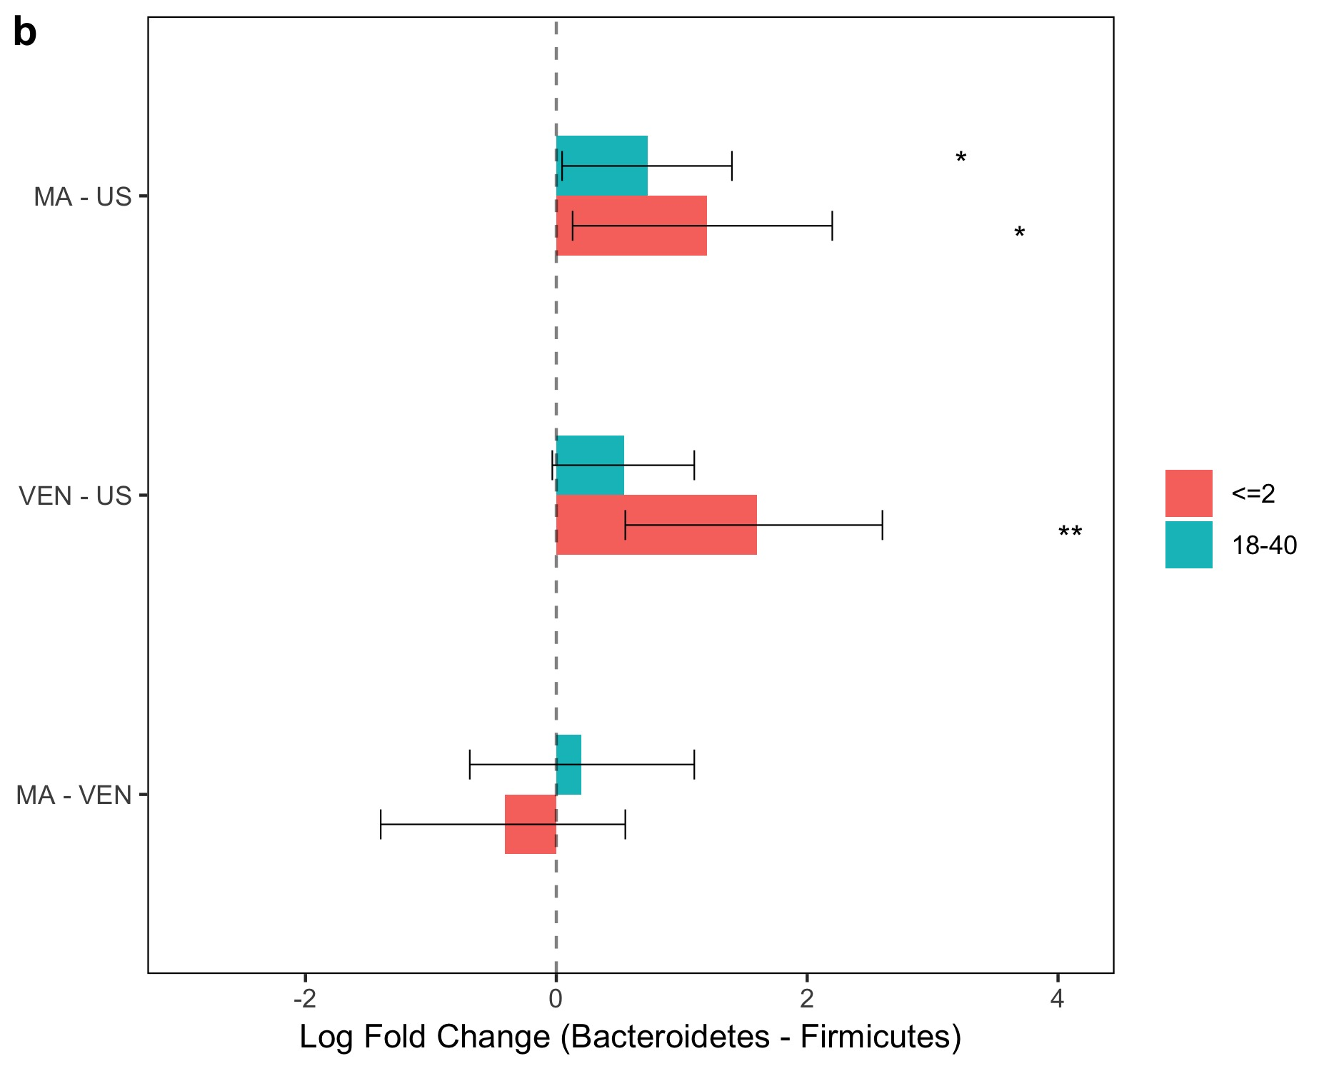

Slide 14
Legend
Fig. 5 Analysis of the global gut microbiota data in phylum level. a Pairwise differential abundance analyses stratified by age using ANCOM-BC: Infants (at most 2 years), and adults (between 18 and 40). Phyla Acidobacteria and Chloroflexi not represented in the plot since they were present only in Venezuela samples. Effect size (in log scale) and Bonferroni adjusted 95% confidence interval bars provided. (*) significant at 5% level of significance, (**) significant at 1% level of significance, and (***) significant at 0.1% level of significance. Diamonds on top of some bars indicate structural zeros. b Pairwise tests using ANCOM-BC for the equality of mean log ratio of Bacteroidetes to Firmicutes stratified by age. Viewing the panel b and Supplementary Table S1 together, lower BMI seems to be associated with higher levels of the Bacteroidetes to Firmicutes ratio, a result widely acknowledged in the literature.

Slide 15
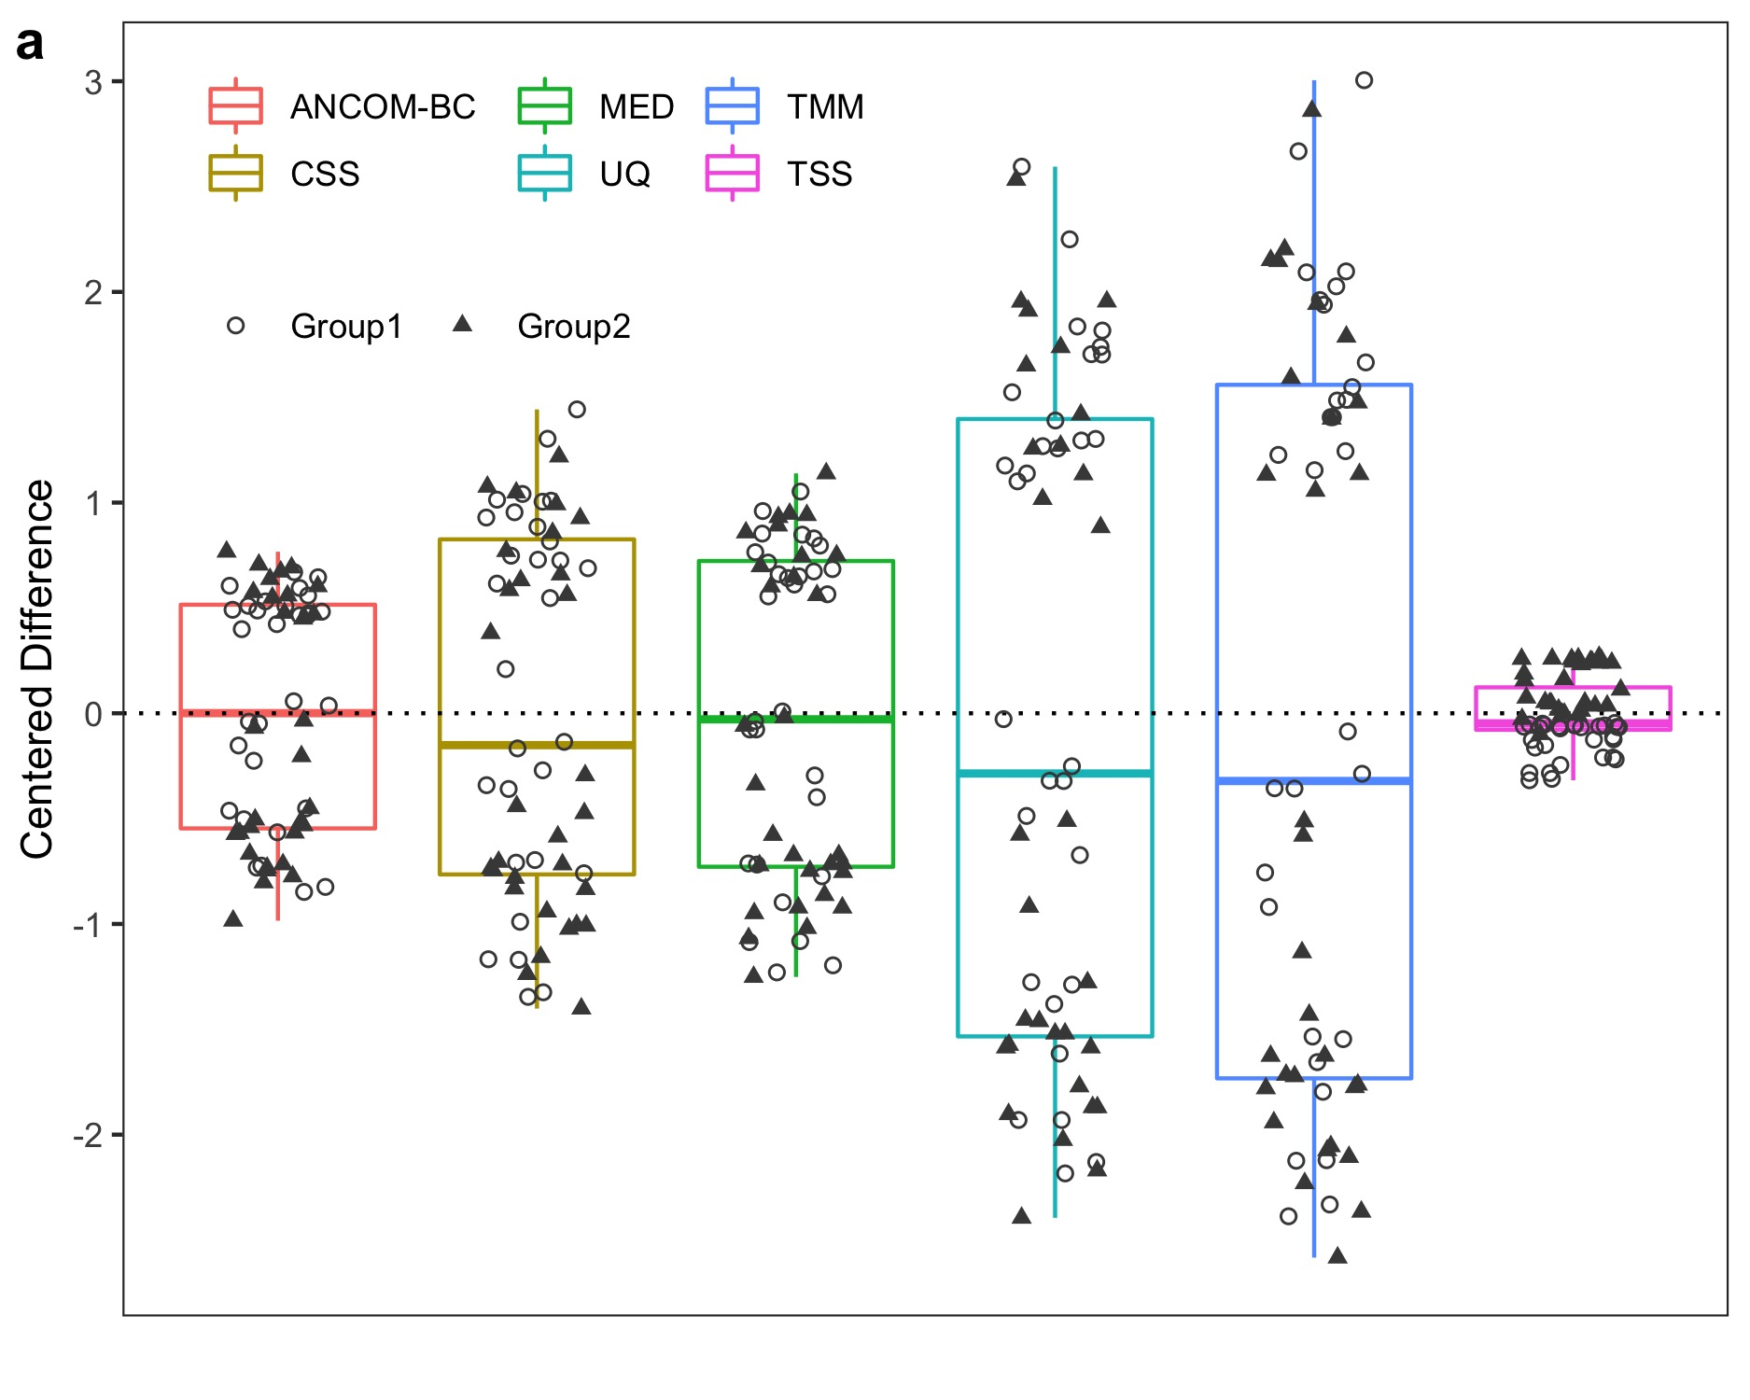

Slide 16
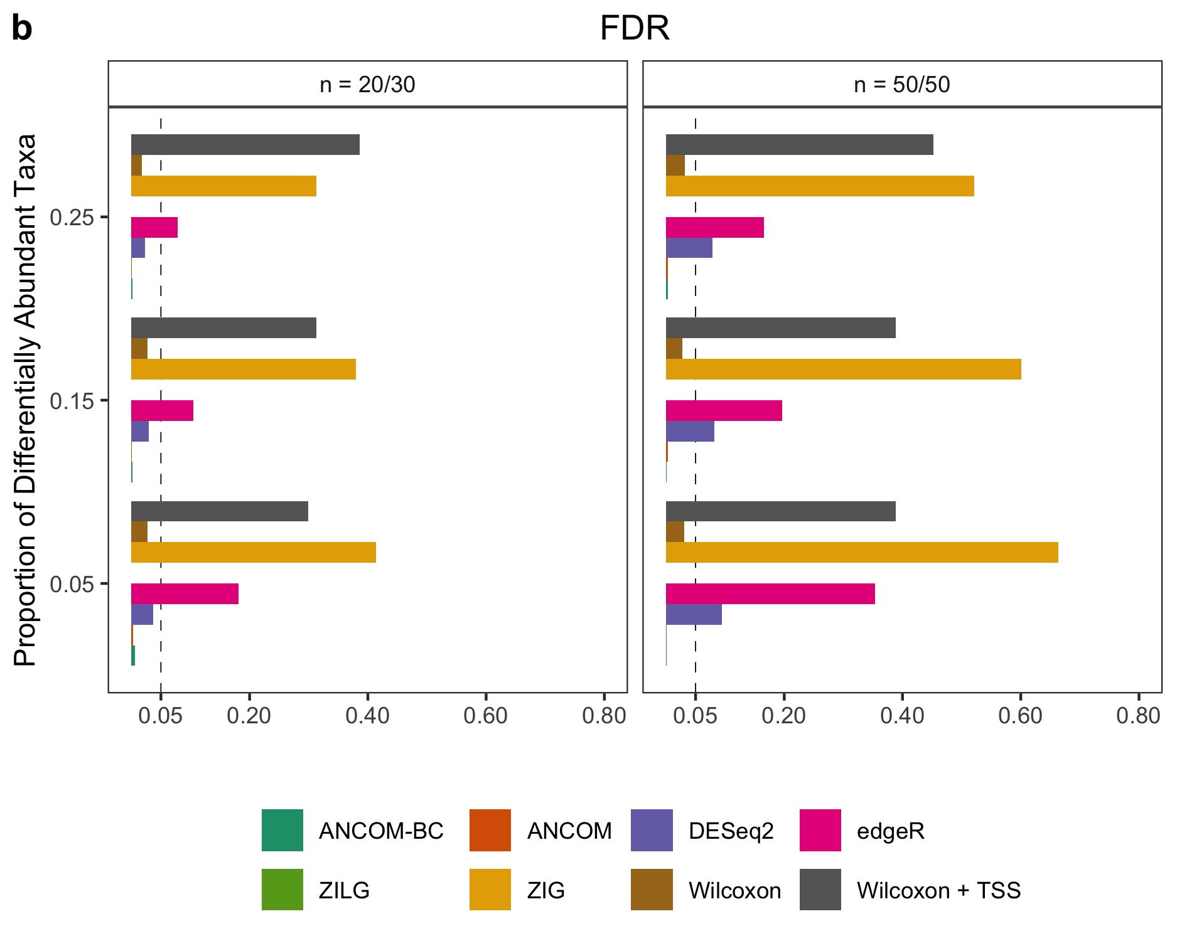

Slide 17
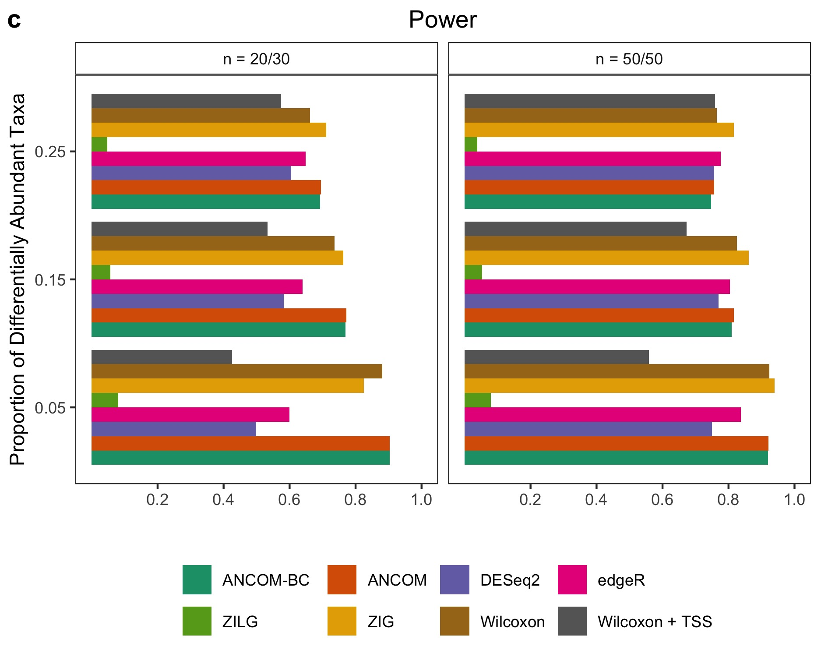

Slide 18
Legend
Supplementary Fig. 1 Bias, FDR and power comparisons using synthetic data with the presence of moderate variable sampling fractions. a Box-plot of centered deviance (centered difference between true sampling fraction and its corresponding estimate) for each specimen. UQ and TMM have the largest variance, MED and CSS have larger variance compared to ANCOM-BC, TSS has the least. As compared to Fig. 3a, the separation of centered deviance shown by TSS is slightly reduced since the variability of sampling fractions is smaller in this simulation data. b, c The False Discovery Rate (FDR) and power of various methods, respectively. The Y-axis denotes patterns of proportion of differential abundant taxa. Results show that ANCOM, ANCOM-BC and the simple Wilcoxon test control the FDR under the nominal level (5%) while maintaining power comparable to other methods in this simulation setting. Gaussian model version of metagenomeSeq has highly inflated FDR, while the log Gaussian version has substantial loss of power, sometimes well below 5%. Other than ANCOM-BC and ANCOM, as the sample size within each group increases, so does the FDR for all other existing methods. Simulation details could be found at Supplementary Information.

Slide 19
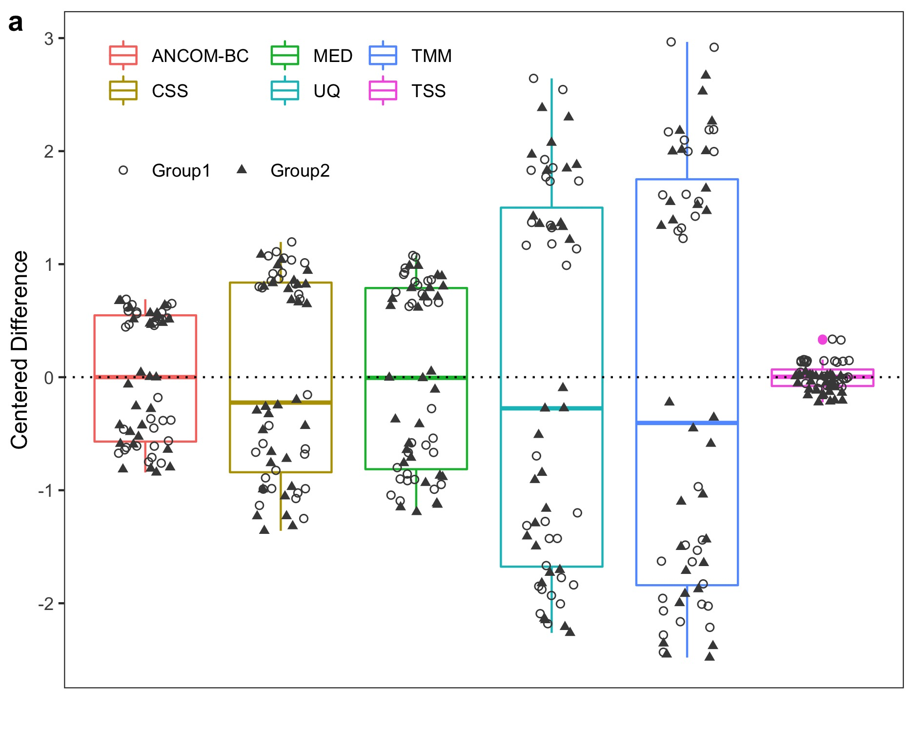

Slide 20
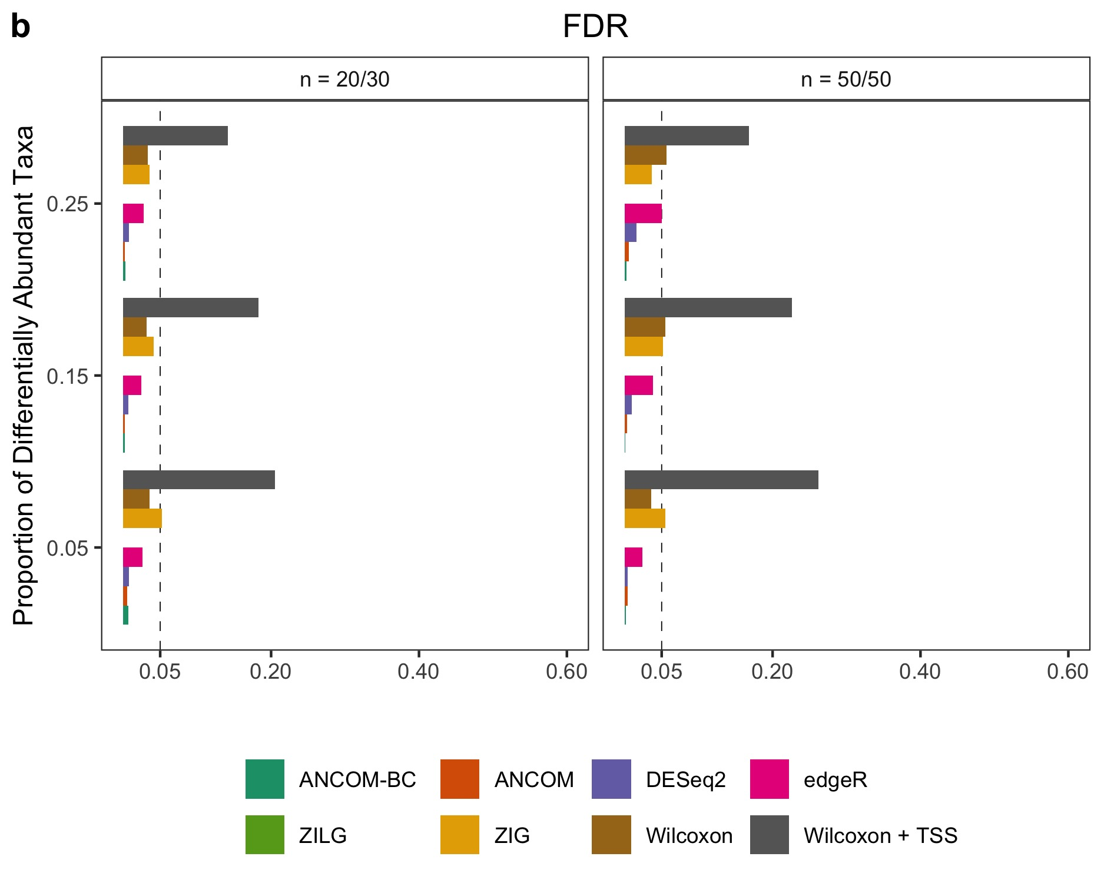

Slide 21
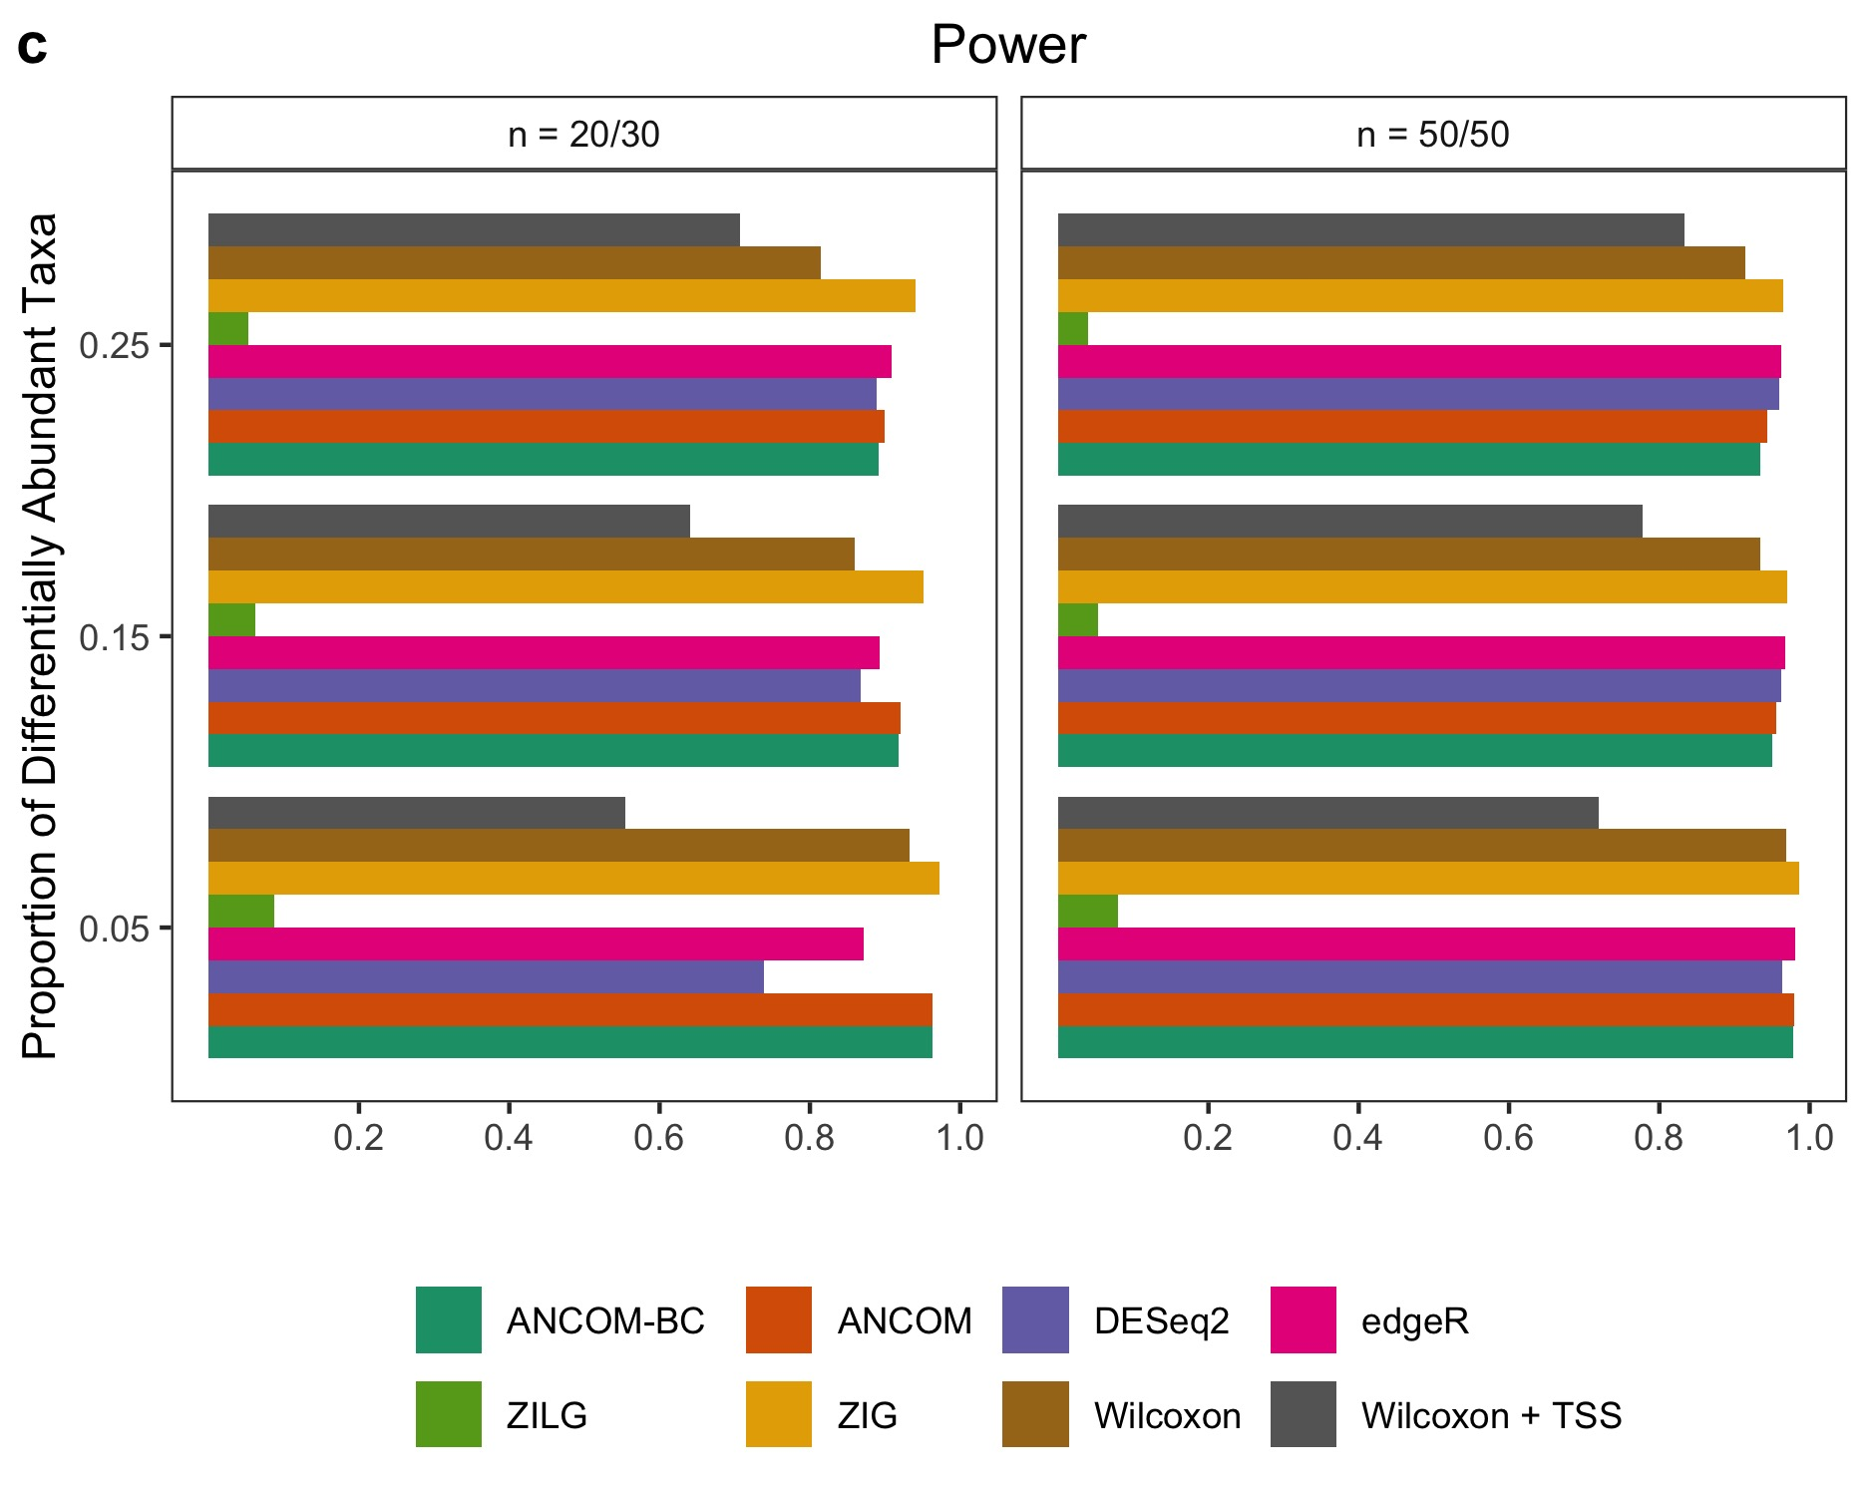

Slide 22
Legend
Supplementary Fig. 2 Bias, FDR and power comparisons using synthetic data with the presence of small variable sampling fractions. a Box-plot of centered deviance (centered difference between true sampling fraction and its corresponding estimate) for each specimen. UQ and TMM have the largest variance, MED and CSS have larger variance compared to ANCOM-BC, TSS has the least. As compared to Fig. 3a and Supplementary Fig. S1a, the separation of centered deviance shown by TSS is gone as the total microbial loads are balanced and the variability of sampling fractions is small in this simulation data. b, c The False Discovery Rate (FDR) and power of various methods, respectively. The Y-axis denotes patterns of proportion of differential abundant taxa. Results show that ANCOM, ANCOM-BC, simple Wilcoxon test and metagenomeSeq using zero-inflated Gaussian mixture model control the FDR under the nominal level (5%) while maintaining power comparable to other methods in this simulation setting. The log Gaussian version of metagenomeSeq has substantial loss of power, sometimes well below 5%. Other than ANCOM-BC and ANCOM, as the sample size within each group increases, so does the FDR for all other existing methods. Simulation details could be found at Supplementary Information.

Slide 23
Supplementary Table 1 (Attached Excel File)
Supplementary Table 1 Results of pairwise differential abundance analyses stratified by age: infants (at most 2 years), and adults (between 18 and 40) using the global gut microbiota data. Differential abundance analyses were performed at the phylum level of the taxonomy. Effect size (in log scale) and Bonferroni adjusted 95% confidence intervals provided. Presence of structural zero is denoted by 1 in the corresponding column and the taxon would be declared as differential abundant automatically (with infinite effect size, zero standard error, and zero q-value).

Slide 24
Infants (Age <= 2)
 | Malawi (n = 56) | The US (n = 49) | Venezuela (n = 28)
Age
Min | 0.033 | 0.083 | 0.250
Max | 2.0 | 2.0 | 2.0
Mean (SD) | 0.99 (0.63) | 0.55 (0.42) | 1.1 (0.58)
BMI
Min | 11 | 14 | 14
Max | 22 | 24 | 19
Mean (SD) | 16 (1.9) | 18 (3.4) | 16 (1.4)
Gender (%)
F | 26 (46) | 26 (53) | 10 (36)
M | 30 (54) | 23 (47) | 15 (54)
NA | 0 (0) | 0 (0) | 3 (11)
Breast-Fed (%)
Y | 56 (100) | 10 (20) | 28 (100)
N | 0 (0) | 27 (55) | 0 (0)
NA | 0 (0) | 12 (24) | 0 (0)

Slide 25
Adults (Age 18 – 40)
 | Malawi (n = 21) | The US (n = 41) | Venezuela (n = 21)
Age
Min | 20 | 23 | 18
Max | 38 | 40 | 40
Mean (SD) | 27 (4.9) | 29 (5.3) | 29 (7.4)
BMI
Min | 20 | 18 | 21
Max | 26 | 66 | 41
Mean (SD) | 22 (2.0) | 27 (11) | 30 (5.2)
Gender (%)
F | 21 (100) | 39 (95) | 20 (95)
M | 0 (0) | 2 (5) | 1 (5)
NA | 0 (0) | 0 (0) | 0 (0)
Breast-Fed (%)
Y | 0 (0) | 0 (0) | 0 (0)
N | 0 (0) | 0 (0) | 0 (0)
NA | 21 (100) | 41 (100) | 21 (100)

Slide 26
Legend
Supplementary Table 2 Summary of demographic variables of the global gut microbiota data.

Slide 27
Log (Bacteroidetes/Firmicutes)
Infants (Age <= 2)
 | Log Fold Change | SE | P-Value
MA – US | 1.2 | 0.53 | 0.028*
VEN – US | 1.6 | 0.53 | 0.0028**
MA – VEN | -0.41 | 0.49 | 0.40
Adults (Age 18 – 40)
 | Log Fold Change | SE | P-Value
MA – US | 0.73 | 0.35 | 0.037*
VEN – US | 0.54 | 0.29 | 0.065
MA – VEN | 0.20 | 0.45 | 0.66

Slide 28
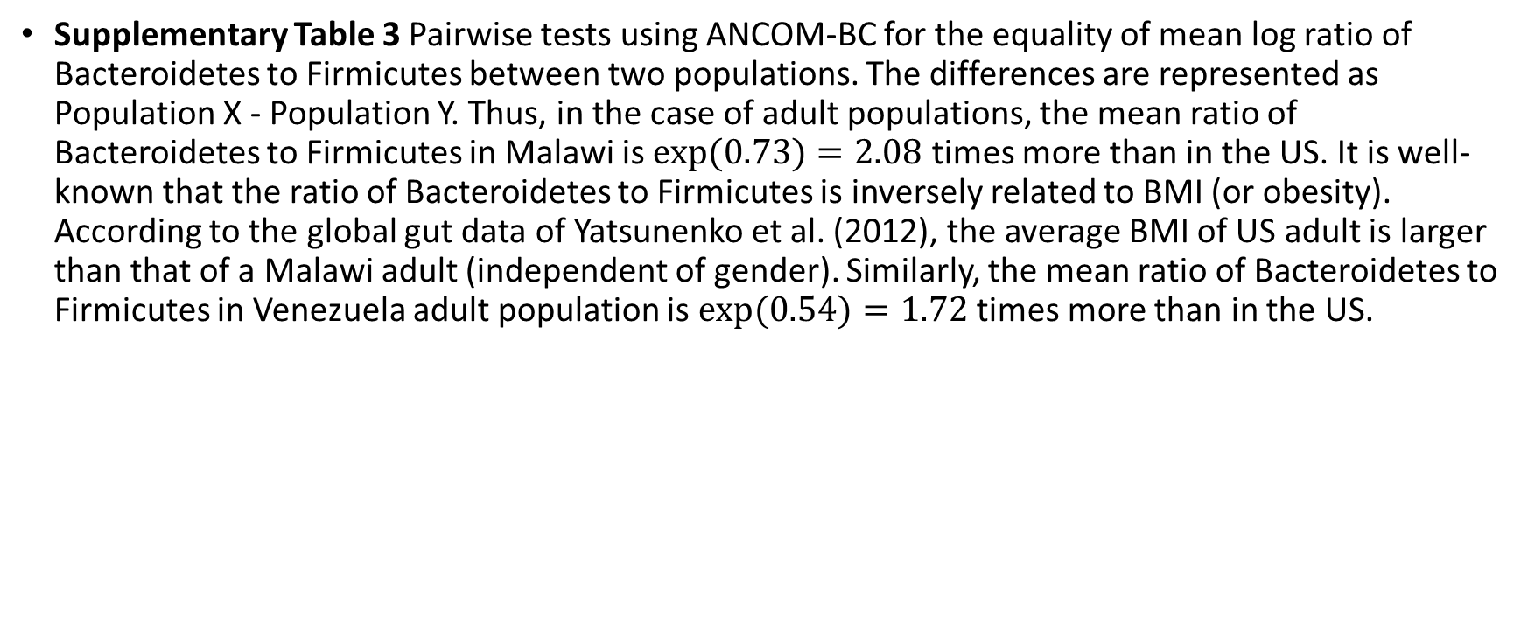
Legend
Supplementary Table 3 Pairwise tests using ANCOM-BC for the equality of mean log ratio of Bacteroidetes to Firmicutes between two populations. The differences are represented as Population X - Population Y. Thus, in the case of adult populations, the mean ratio of Bacteroidetes to Firmicutes in Malawi is $exp⁡(0.73)=2.08$ times more than in the US. It is well-known that the ratio of Bacteroidetes to Firmicutes is inversely related to BMI (or obesity). According to the global gut data of Yatsunenko et al. (2012), the average BMI of US adult is larger than that of a Malawi adult (independent of gender). Similarly, the mean ratio of Bacteroidetes to Firmicutes in Venezuela adult population is $exp⁡(0.54)=1.72$ times more than in the US.

